Slide 1

Title slide – Figtree Bold 48

Slide 2
Title FIGTREE BOLD pt 36
Bullet points
Font MONTSERRAT

Slide 3

Version with illustration
Community led

Slide 4

Version with illustration
Faith

Slide 5

Version with illustration
Social justice

Slide 6

Version with illustration
Britain and Ireland focused

Slide 7

Version with illustration
Worldwide focused

Slide 8
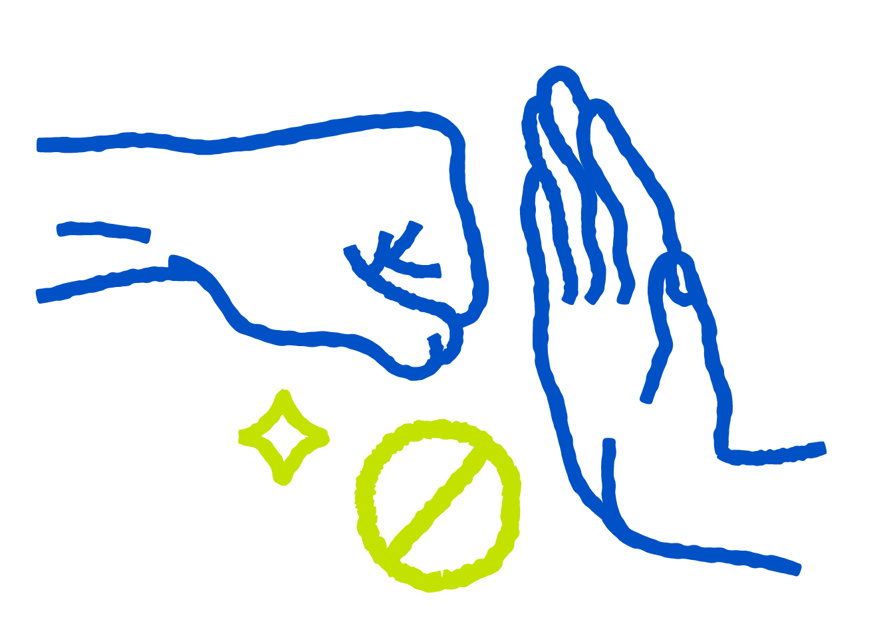
Version with illustration
Ending violence

Slide 9

Version with illustration
Ending poverty

Slide 10

Version with illustration
Sustainable change

Slide 11




What we do - Our three pillars
Ending Violence
Ending Poverty
Ending Injustice
3
|

