Slide 1


Slide 2
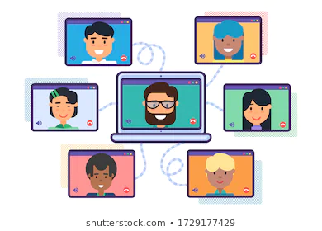
Welcome to our
Zoom Council Meeting
7th December 2020
at 10.00 am

Slide 3

At the beginning of our time together, let us pray:
Almighty God, everything you do reveals your glory and majesty... As we gather today we pray that you would fill our hearts, our minds
and our souls. Be with us in our meeting
this morning, and with those unable to
join us today. We thank you for this
opportunity to come together through
Jesus Christ, our Lord, Amen

Slide 4

Next year’s theme will be -

Slide 5


Welcome to our virtual Autumn Council Meeting
Apologies
Conflict of Interest
Minutes
Diocesan President’s Remarks
Treasurer’s Report
Trustees Reports
Upcoming Services
Diary Dates
A.O.B
Closing prayer

Slide 6
Lots of information!
You will already have received your Prayer Diaries – not yet on the MSH database? - Tell us…
Christmas Appeal: Opportunity to give TODAY for overseas work – the BIG GIVE!
Christmas Letter from Sheran Harper, Worldwide President
MSH invite to the 9 Lessons and 9 Carols – a virtual festive tradition….. 17th December at 7.30 pm
Our own Blue Christmas Service on the 21st December at 5.00 pm
New Branch/Bubble meeting to introduce MU theme - from January (45 mins)
Other news has already been circulated in my earlier email
Latest information from our East Anglican Cluster group – (? 2022 subs, etc.)
All change! - MSH new ways of working include -
New magazine, Microsoft Teams, webinars, monthly newsletters/reflections
Next St Eds and Ips MU diocesan newsletter coming out mid-December
Book of Comfort (and prayers/Bible readings for these covid-times…)

Slide 7
From the floor? …. or email us….?
Yours Thoughts?
Comments?
Issues?
Newsletter? – frequency?
Online activities - too exclusive?
Social media?
Zoom?
… or what?

Slide 8
Change happens:
Things are constantly evolving
Our God is a Creator God….

Slide 9
Changes:
Nominations for Trustees and Officers
How to do Council meetings?
Direct Debit payments for subs
Communities of Interest
Webinars, training, information, resources
Publications
Tell us your news, share your stories – local happenings…
Newsletters from MSH, Diocesan, Branch and twice-yearly magazine on the doorstep, Prayer Diary

Slide 10
Future meeting formats? Double zoom sessions,
breakout groups, interactive, questions and answers, discussions, voting, sharing stories
Everyone now needs access to our website
- (musuffolk.org) and
- MSH (mothersunion.org)
for current information and to keep up to date
Spiritual input and growing deeper in our Christian faith
Learning how to cope with all these changes together

Slide 11
OUR “ABC STRATEGY” … remains unchanged but expands to include
AFIA - Key workers
BEFRIENDING - Getting our clergy on board:
welcome packs for curates when they are priested
Invitations to new incumbents
Focusing on our own clergy, Lay Elders, Churchwardens and leaders
BEREAVEMENT
Loss, grief, sadness.loneliness, isolation. (Publicity)
“Bags of Love”
CLEWER - not only
Modern Day Slavery (car wash, farm workers video
But also ….
16 Day of Activism, domestic violence, gender inequality (No more 1 in 3 campaign)

Slide 12

Next Council Meeting will be our
Annual General Meeting
17th March 2021

Slide 13
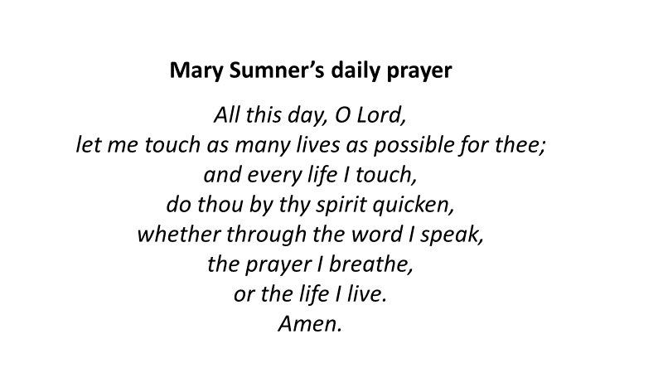
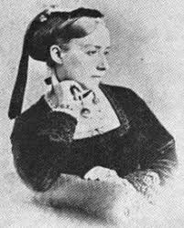

Slide 14
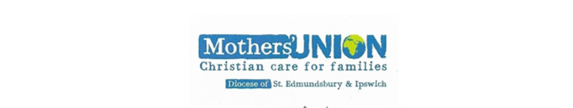
We say together:
The grace of our Lord Jesus Christ, the love of God, and the fellowship of the Holy Spirit be with us all and those we love, in Jesus Name, Amen
Thank you for joining us this morning!

